Slide 1
Federal IT Dashboard
Technical Meet & Greet
Prepared by TCG

Slide 2
Agenda
01 | WELCOME/INTRODUCTIONS
02 | EXECUTIVE SUMMARY
03 | WHO WE ARE
04 | HOW WE OPERATE
05 | DASHBOARD INFRASTRUCTURE
06 | GUIDED TOUR OF THE DASHBOARD
07 | Q&A
08 | CLOSING REMARKS

Slide 3
Executive Summary
In close collaboration with the Office of the Federal Chief Information Officer (OFCIO), TCG has served as the primary provider of development, operations, and maintenance support to the Federal IT Dashboard since July 2015.
Since then, the Federal IT Dashboard has undergone major change and has been iteratively-developed in close parallel with the release of OMB policy and guidance.
The Federal IT Dashboard’s development team uses an agile project management approach to deliver releasable product increments every two-weeks with development tasks prioritized and reviewed by OMB.
The team also provides assistance to the vendors, agencies, and the public by responding to inquiries received via the IT Dashboard Support mailbox, GitHub, and through regular touchpoints with members of the CPIC community.

Slide 4
Justin Grimes
Product Owner/
OMB Policy Analyst
Austin Moffa
Technical Lead/Developer
Jeremiah Burch
Scrum Master
Tsitsi Liywalii
Business Analyst
Kimler Corey
System Architect
Chris Murphy
Developer
Kim Pohland
QA Specialist
Samira Isber
QA Specialist
Kevin McKernin
DBA/Developer
Chad Day
Developer
Lynette Hornung
QA Specialist/Security SME

Slide 5
What we do…
Product Owner – Primary interface between OMB Policy Analysts, Desk Officers, Resource Managers, and dashboard’s stakeholders. Sets and conveys vision for the Federal IT Dashboard.
Scrum Master – Primary interface between the Product Owner and the development team. Assists the Product Owner and the team in planning and prioritizing work, maximizing productivity, and employing agile development practices.
Technical Lead – Establishes a technical vision and provides direction for the solutions developed by the development team. Primary spokesperson on the technical implementation of the dashboard.
Business Analyst – Identifies stories, tasks, and defects with the dashboard, gathers/clarifies requirements, maintains product documentation, and oversees responses to inquiries received via the help desk
Developers/DBAs – Transform stories, tasks, and bug/defect fixes into functioning code. Oversees the overall administration, operation, and maintenance of the dashboard.
QA Specialists – Ensure product and developed increments are thoroughly tested, meet acceptance criteria, and will function as expected. Identifies and logs bugs/defects found within the dashboard.

Slide 6
Intake and Requirements Gathering
All stories, feature requests, bugs, and defects are logged as tickets in JIRA
Tickets are reviewed by the Scrum Master and enter into a planning backlog and become subject to a grooming process
Tickets selected for grooming are assigned to Business Analysts and other team members for requirements gathering and review
Once all known requirements are gathered, tickets are reviewed by the development team to ensure the ticket is clear enough to be marked as Ready for Development
Tickets then enter into the Product Backlog for prioritization into a future sprint
Tickets that are not ready for development are assigned to be elaborated further

Slide 7
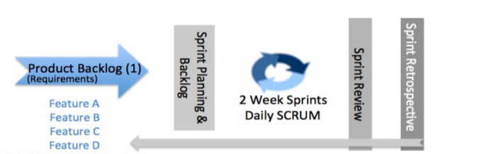
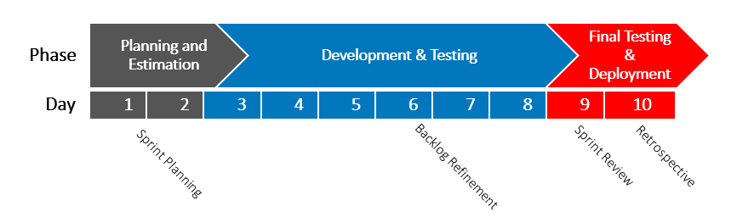
IT Dashboard Development Process
Two-week sprint cycles
Managed Product and Sprint Backlogs
One-week security audit prior to deployments
Sprint Review conducted with Product Owner
Sprint Status Report Delivery
Refinement focuses on next sprint

Slide 8

Hosting Infrastructure
The Federal IT Dashboard is hosted using MAX.gov’s Shared Services platform
Logged-in access to the dashboard is facilitated via MAX Authentication Services, a Central Authentication Service (CAS).
The Federal IT Dashboard’s development team works closely with MAX.gov Support to operate and maintain the environment which hosts the dashboard
This includes:
Security Scanning and Audits
Maintenance of the dashboard’s support systems
Server access and troubleshooting

Slide 9



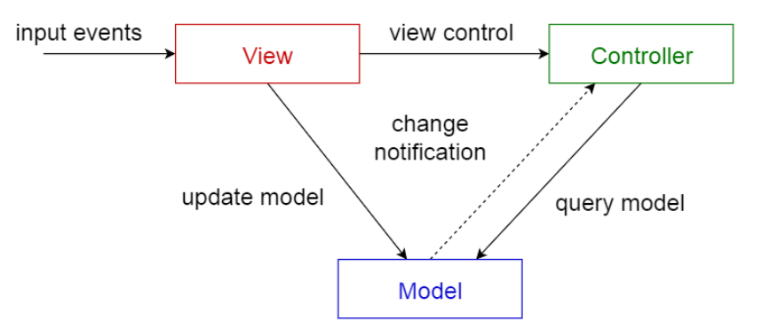


Tech Stack and Software Architecture
The Federal IT Dashboard is built on a LAMP stack and is primarily a PHP-driven product
The Content Management System (CMS) used for the dashboard is Drupal 7
Versions currently in use are as follows:
Red Hat Enterprise Linux – 6.8
Apache Web Server – 2.2
MySQL – 5.6
PHP 5.3
Drupal 7.59
Software Architecture is primarily Model-View-Controller (MVC)

Slide 10
Other items that may be of note…
The development team maintains the development code base within the team’s GitHub repository.
System baseline deployments and releases are promoted from the team’s repository to the MAX.GOV repository.
The team primarily uses Splunk for all system audit logs (API, Server, and MySQL).
In addition to monitoring by MAX support, Monit is also used as a system supervision tool to evaluate and improve the “health” of the Federal IT Dashboard and its support systems.

Slide 11
Guided Tour of the IT Dashboard

Slide 12
Questions?

Slide 13
Thanks!

Slide 14
Jeremiah.G.Burch@omb.eop.gov

